Slide 1
Closer look at the functions

Slide 2
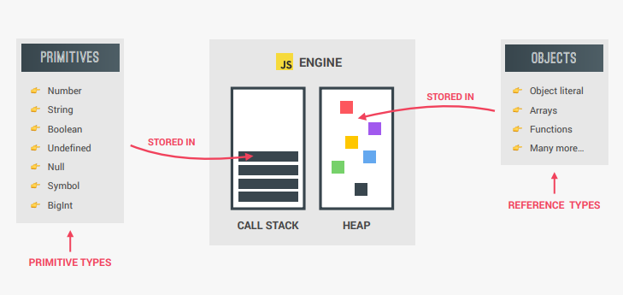
First let’s check this out
Primitives vs Objects

Slide 3
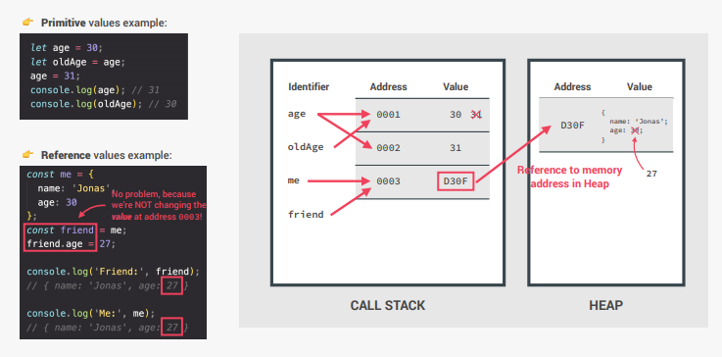
Primitives VS Objects (show in code)

Slide 4
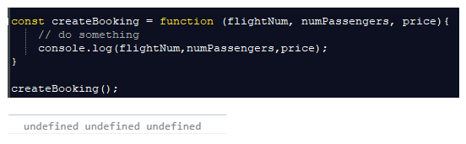
Default value of the function’s agruments
When we don’t provide values to the function, then JS engine will see it as Undefined.
To avoid having undefined in this case, we are setting the default value

Slide 5

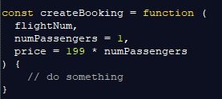
Default values
Previous versions
Newer versions (similar to that of C#)

Slide 6
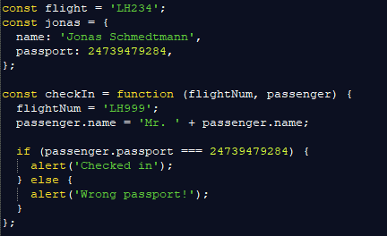


How passing arguments works

Slide 7
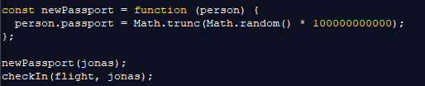
How passing arguments works
Let’s see what happens when we have the new function:
So because of our bug passenger can miss the flight!

Slide 8
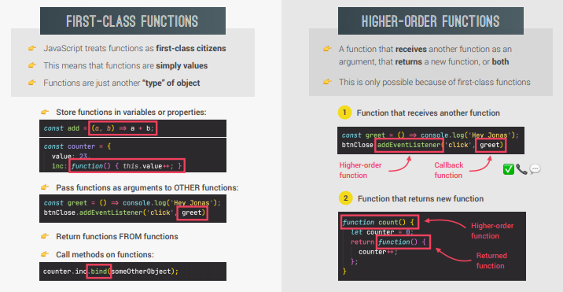
First class vs higher-order functions

Slide 9
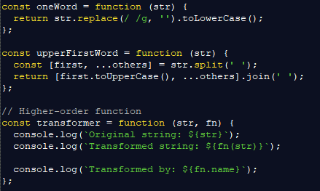

Functions accepting callback functions
This is a special situation when you want to do:
function(someData, anotherFunction) {
}
Similar situation we had in our addEventListener(‘click’,doSomething)

Slide 10
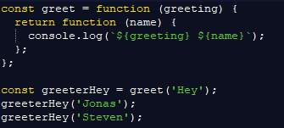

Function returning function
It is something we will not use much, but it is still there:
So there is another way we can execute this function:

Slide 11
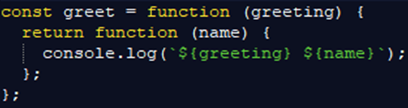
Challenge 1
Let’s use arrow functions in the previous example (see below):

Slide 12
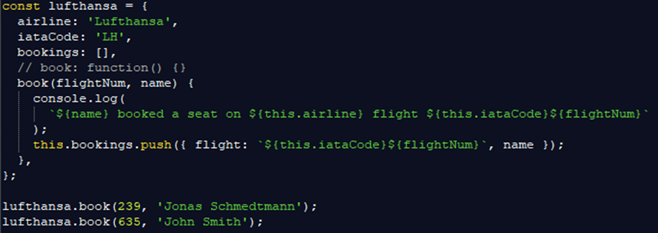
This keyword troubles 1
Let’s see this situation – We have an airline company called Lufthansa that allows us to book tickets:

Slide 13
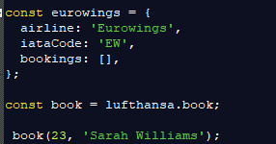
This keyword troubles 2
Let’s see what happens if that company decides to open another company called Eurowings that will keep the same book method, by borrowing it from Lufthansa:

Slide 14


Solution to the problem (‘call’ and ‘apply’)
Well since This keyword is not possible to manually set within the simple function, we can use some helper functions:
CALL:
APPLY:

Slide 15


Bind
Another way to solve the previous problem is by using Bind
This is by far the most popular way
By using Bind you will set the THIS keyword for the function
Check if you can predefine booking number as well, so you don’t need to enter it each time you call the function

Slide 16
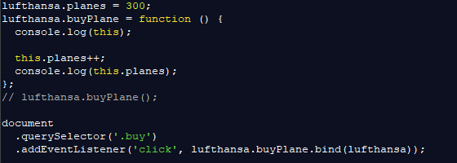
Let’s see it with Event listeners
This keyword in situation below will be – a button element, not Lufthansa.

Slide 17
Challenge 2
Let’s make a VAT calculating function
calculateVAT(rate,value)
Rate – percentage of the tax
Value – how much money should we tax
Example: calculateVat(23,100) → result should be 23
Now for this function, use bind to make function for preset following tax rate:
33
40
15

Slide 18
Homework
Go to slide 12
Use same logic as for Lufhansa to make the flight company Delta Airlines
Beside book function, add another one: showDetails()
The function showDetails() should show all the properties in alert().
So show: company name, iata code, passenger name

